Slide 1
Company XYZ
Consumer Risk Analysis
Risk Department - Scott

Slide 2
About
XYZ

Slide 3
Driving Financial Inclusion through Responsible Lending
XYZ
XYZ strives empower individuals on their financial journey by providing credit solutions while prioritizing responsible lending practices.

Slide 4
The
Problem

Slide 5
Identifying and Mitigating Credit Risk
Credit Risk
Default
Analysis
Loans -- major risk factor affecting our financial health
Unpaid loans on balance sheet lead to financial stress
Mitigate risk by implementing a robust system

Slide 6
Dataset

Slide 7
150,000
35,137
10,026
consumers, ages 21 - 109
consumers w/ monthly debt > income
consumers w/ serious delinquencies in 2 years

Slide 8
Predictor Insights
Big Money
Lending a Hand
Credit Crisis
Highest income: $3 million
>31,000 consumers w/ no reported income
Majority of consumers have 8+ open lines of credit
In-Dependents Day
Dependent-able
Get Real-Estate
57% -- No dependents
10: 5 consumers
13: 1 consumer
20: 1 consumer
<7% consumers have >2 real estate loans (max of 54!)

Slide 9
Filling the Gap
19.8%
2.6%
Monthly Income
Number of Dependents
29,731 missing values will be filled using the most frequent value of 5,000
3,924 missing values will be filled with the most frequent value of 0

Slide 10
Get Out of Here!
 | Threshold | # Values Dropped | Percent of Total Values
Debt Ratio | > 3839 | 2,999 | 2.00%
Revolving Utilization of Unsecured Lines | >1.35 | 765 | 0.51%
Number of Times 90 Days Late | >17 | 269 | 0.17%

Slide 11
Important Features
Revolving Utilization of Unsecured Lines
01
Number of Times 90 Days Late
02
Number of Open Credit Lines and Loans
Number of Times 60-89 Days Past Due Not Worse
03
04

Slide 12
Result

Slide 13
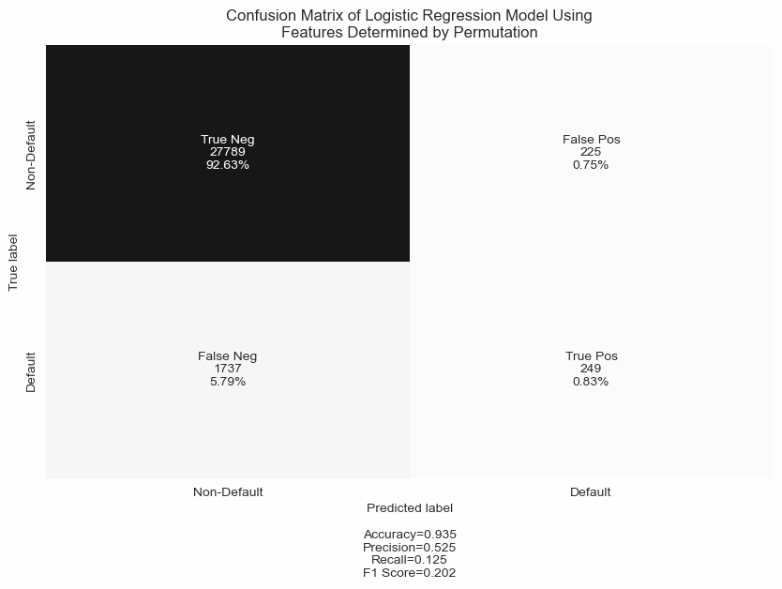
Model Behavior
Achieved a 93.5% accurate model!
Unfortunately, these results are deceiving for multiple reasons:
93.3% of consumers didn’t default
Guessing “non-default” is just as accurate
6.7%
93.3%

Slide 14
Future Improvements
Additional
ensemble
models
Balance the
dataset
MICE
imputation
Feature
engineering
Fine-tuning
(KFold-CV, grid search)

Slide 15
Simple Solutions

Slide 16
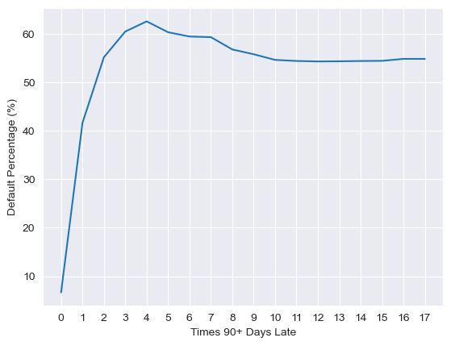
Nein-ty Days
Being 90+ days late on a payment even once should be flagged
2 or more times is a serious risk

Slide 17
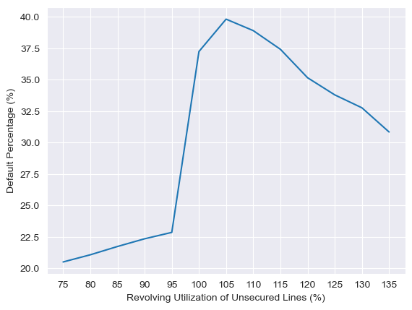
Major Un-security Issues
100-115% utilization of their unsecured lines of credit should also be flagged

Slide 18
Summing It Up
Model needs improving
Consider rejecting consumers:
  >2 times 90+ days late
  100-115% utilization of unsecured credit lines

Slide 19
Thanks!
Any questions?
scott@xyz.com
XYZ Company

Slide 21
The Slide Title Goes Here!
Do you know what helps you make your point clear? Lists like this one:
They’re simple
You can organize your ideas clearly
You’ll never forget to buy milk!
And the most important thing: the audience won’t miss the point of your
presentation

Slide 22

A Picture Is Worth a Thousand Words

Slide 23
Alternative Resources
Find more illustrations like these on Stories by Freepik

Slide 24
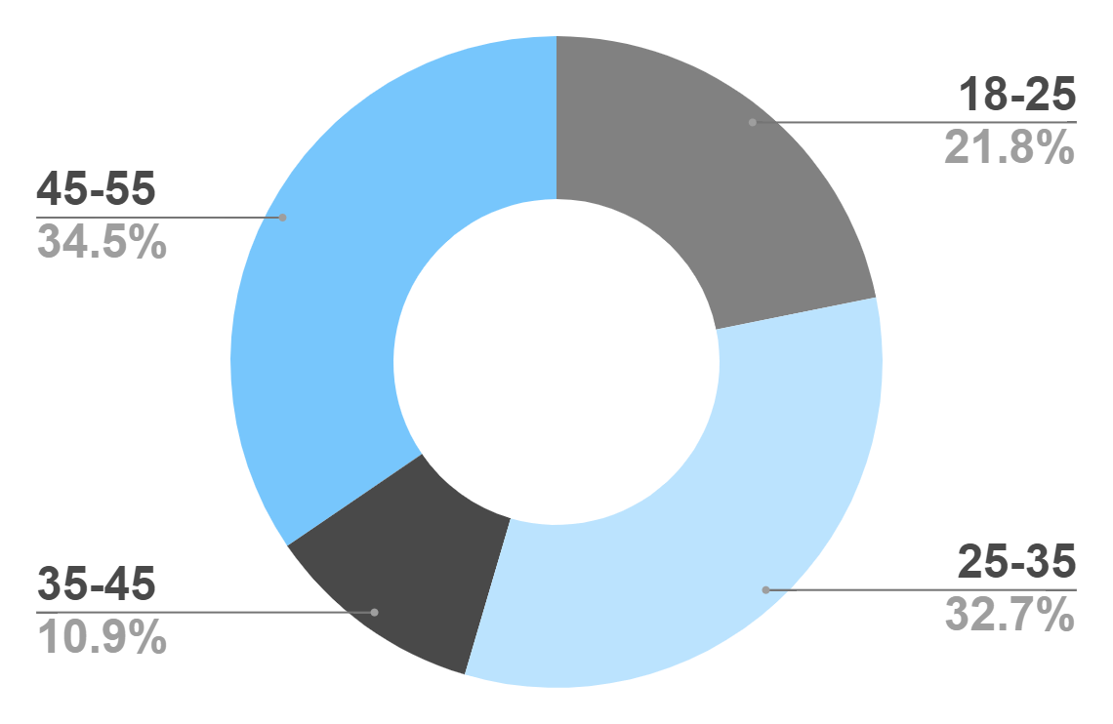
Target
Age
Gender
30%
70%
Interests
Security
Usability
To modify this graph, click on it, follow the link, change the data and paste the new graph here
Interface

Slide 25
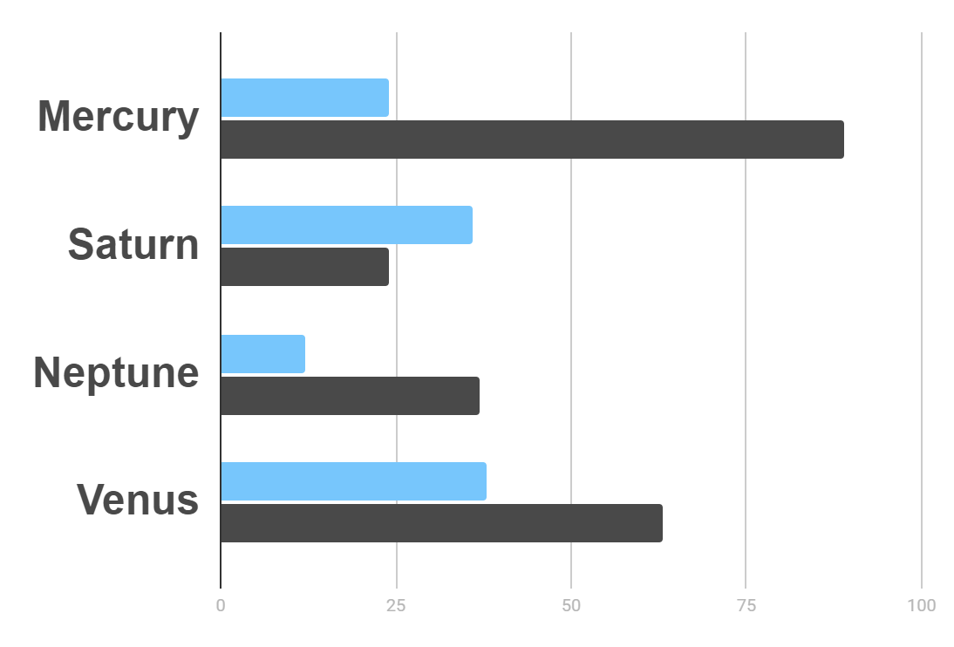
Market Research
Evolution
$20K
Gross Revenue in the Sector
10%
45K
To modify this graph, click on it, follow the link, change the data and paste the resulting graph here
Sector Growth

Slide 26
Business Icons
Teamwork Icons

Slide 27
...and our sets of editable icons
You can resize these icons without losing quality.
You can change the stroke and fill color; just select the icon and click on the paint bucket/pen.
In Google Slides, you can also use Flaticon’s extension, allowing you to customize and add even more icons.

Slide 28
Educational Icons
Medical Icons

Slide 29
Help & Support Icons
Avatar Icons

Slide 30
Creative Process Icons
Performing Arts Icons

Slide 31
Nature Icons

Slide 32
SEO & Marketing Icons

